Slide 1
Deep Neural Networks
Itay Hazan
Some slides are taken from Andrew NG Deep Learning Course

Slide 2
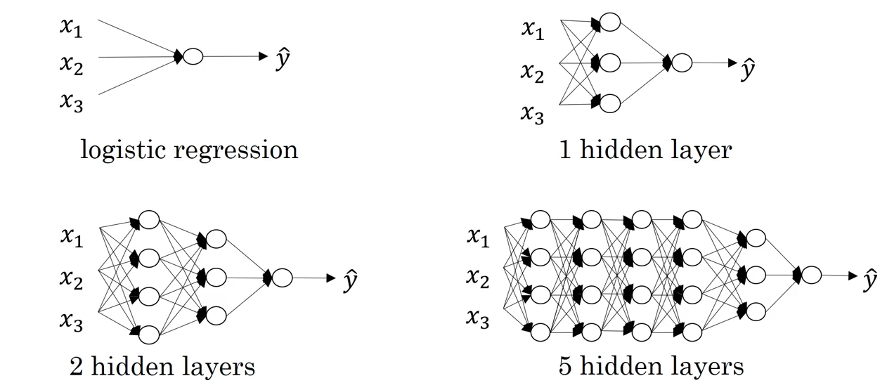
What is a deep neural network?
“Shallow”
“Deep”

Slide 3
Deep Neural Networks: Notation
$$x_{1}$$
$$\hat{y}$$
$$x_{2}$$

Slide 4


Deep Neural Networks: Notation
$$x_{1}$$
$$\hat{y}$$
$$x_{2}$$

Slide 5





Deep Neural Networks: Notation
$$x_{1}$$
$$\hat{y}$$
$$x_{2}$$

Slide 6












Deep Neural Networks: Notation
$$x_{1}$$
$$\hat{y}$$
$$x_{2}$$

Slide 7


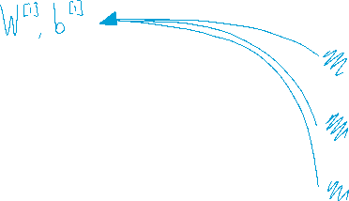






Deep Neural Networks: Notation
$$x_{1}$$
$$\hat{y}$$
$$x_{2}$$

Slide 8

Deep Neural Networks: Notation
$$x_{1}$$
$$\hat{y}$$
$$x_{2}$$

Slide 9

Intuition about deep representation

Slide 10

Intuition about deep representation

Slide 11
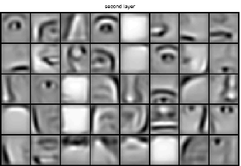


Intuition about deep representation

Slide 12
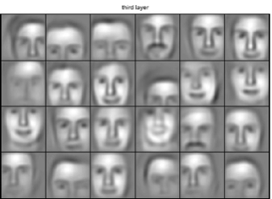
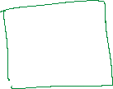

Intuition about deep representation

Slide 13



Intuition about deep representation
$$\hat{y}$$

